Slide 1
VolunteerUnited
Empowering volunteers. Enhancing impact.
By Delaney Brown, Will Herndon, Nerea Lancho Poza, and Hieu Nguyen
01

Slide 2
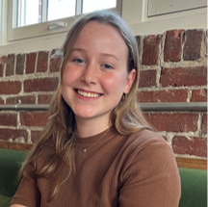
Delaney Brown Development Team
Nerea Lancho Poza
Development Team
Hieu Nguyen
Development Team
William Herndon
Development Team
Meet HumanityAid AI
02

Slide 3
Executive Summary
Introduction
Marketing
Value Proposition
LLM integration
Market Analysis
SWOT
Persona Analysis
PLC & Promotional Plan
Supply Chain
Finance
Application Development
Functions
Wireframe
App Management
Final Capital Budgeting
Product Pricing Analysis
Sales Analysis
Financial Considerations
Sensitivity Analysis
Project Decision
03

Slide 4
VolunteerUnited provides volunteers of nongovernmental organizations with immediate assistance, vital information, translation services, and communication coordination to make emergency response more accurate and effective.
Value Proposition
04

Slide 5
LLM- Chat GPT 3.5 Turbo 4k
Supports features of VolunteerUnited
_{Predictive Analysis}
_{Data Analysis}
_{Rapid information retrieval}
Communication across language barriers
05

Slide 6
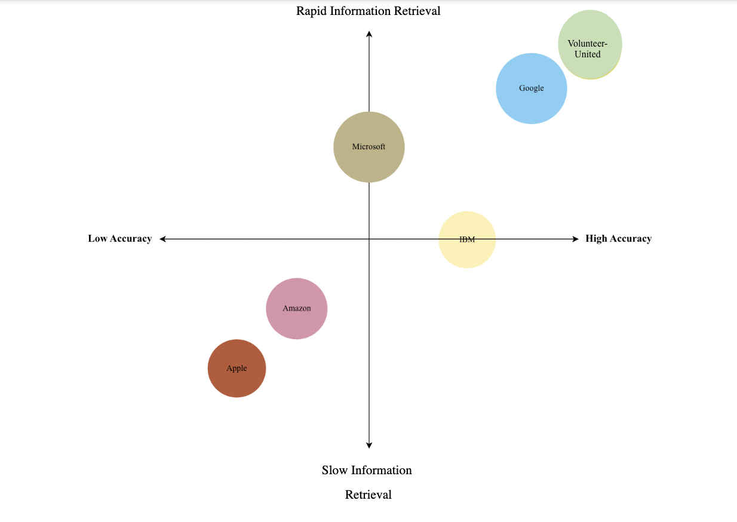
Market Analysis
Target Market: Non-Governmental Organizations
Red Cross
Save the Children
All Hands and Hearts
Mercy Corps
06

Slide 7
Strengths
Provide immediate assistance and guidance to volunteers in the emergency response industry
Translation services/communication coordination
Compilation of data is used to develop the app and predict needs
Weaknesses
Consumers doubt the security of the storing of their medical information
Credibility when compared to existing emergency response channels
Lengthy app development leads to higher cost
Opportunities
Greater return on investment for disaster planning
Language barriers between responders and victims can make it difficult to provide the appropriate aid
New litigation protecting NGO workers during medical and natural disasters
Threats
Diverse regulations for workers performances based on location
New requirements for NGO’s accommodations for various locations
Increases in the development of emergency response apps
07

Slide 8
Persona
Nicki the NGO CEO
Works for the Red Cross and oversees the buying center
Emphasizes dispersing volunteer support over a wide variety of areas
08

Slide 9
Promotional Plan
40-second-long promotional video via social media.
Volunteer footage of their work in the field utilizing the app.
Testimonies from volunteers regarding the benefits the application has brought into their work.
"I AM A VOLUNTEER AND I USE VOLUNTEERUNITED"
09

Slide 10
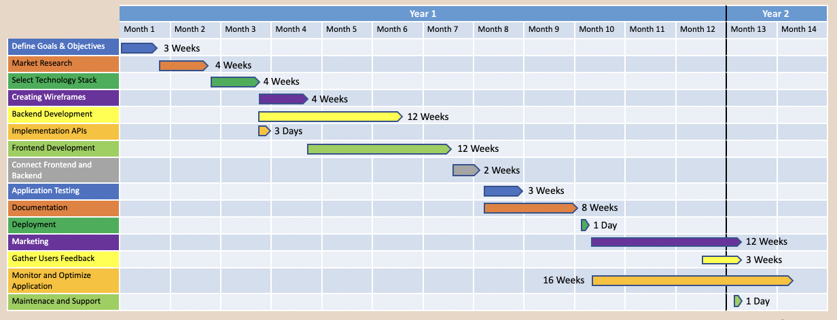
Application Development
 | Year 1 |  |  |  |  |  |  |  |  |  |  |  | Year 2
 | Month 1 | Month 2 | Month 3 | Month 4 | Month 5 | Month 6 | Month 7 | Month 8 | Month 9 | Month 10 | Month 11 | Month 12 | Month 13 | Month 14
Define Goals & Objectives
Market Research
Select Technology Stack
Creating Wireframes
Backend Development
Implementation APIs
Frontend Development
Connect Frontend and Backend
Application Testing
Documentation
Deployment
Marketing
Gather Users Feedback
Monitor and Optimize Application
Maintenace and Support
3 Weeks
4 Weeks
4 Weeks
4 Weeks
12 Weeks
3 Days
12 Weeks
2 Weeks
3 Weeks
8 Weeks
1 Day
12 Weeks
3 Weeks
16 Weeks
1 Day
10

Slide 11
App Management
Customer Support
Gather user feedback
Based on user activity
Quality assurance testing
Beta testing
Regular Updates
Corrective Maintenance
Bug fixes
Performance Optimization
24/7
Chat box
Technical agents
10
11

Slide 12
Primary Functions
Rapid Information Retrieval
API: Chat GPT 3.5 Turbo 4K
Predictive and Data Analysis
API: Chat GPT 3.5 Turbo 4K
Training / Onboarding
Translation/ Communication services
API: Microsoft Azure Whisper
Geographic Services / Navigation
API: Google Maps
Specialized Storage System/ Resource Coordination
12

Slide 13
Sales Analysis
Units Sold Each Year
Year 1 Forecast of 279,650 units
Year 2 Forecast of 419,475 units
Year 3 Forecast of 559,300 units
Year 4 Forecast of 559,300 units
Year 5 Forecast of 559,300 units
Red Cross
Save the Children
Product Pricing
Year 1 $49.99
Year 2 $41.66
Year 3 to Year 5 $36.31
All Hands and Hearts
Mercy Corps
Price Per Unit= (total cost per unit * 1+ RR)
WACC/RR= 20.39%
13
Notes:
Sales Unit Forecast – 279,650 for year 1
Numbers for 2 for 5 are estimated sales if we are targeting Red cross, save the children, All hands and hearts, and Mercy Corps (4)
Initial Capital Budgeting Document – sales projections are the volunteers for these organizations added up
-559,300
Yr 1 is 50%
Yr 2 is 75%
Yr 3 – 5 100%
Sales Price:
-declines each year
-year 1 (total cost per unit * 1 + required return) = 20.39 %
-year 1 49.99 price
-normal math 51.18 with required return ( priced it at 49.99 because we want price to be under $50)
-year 2-5 (use tcpu * 1 + rr)

Slide 14
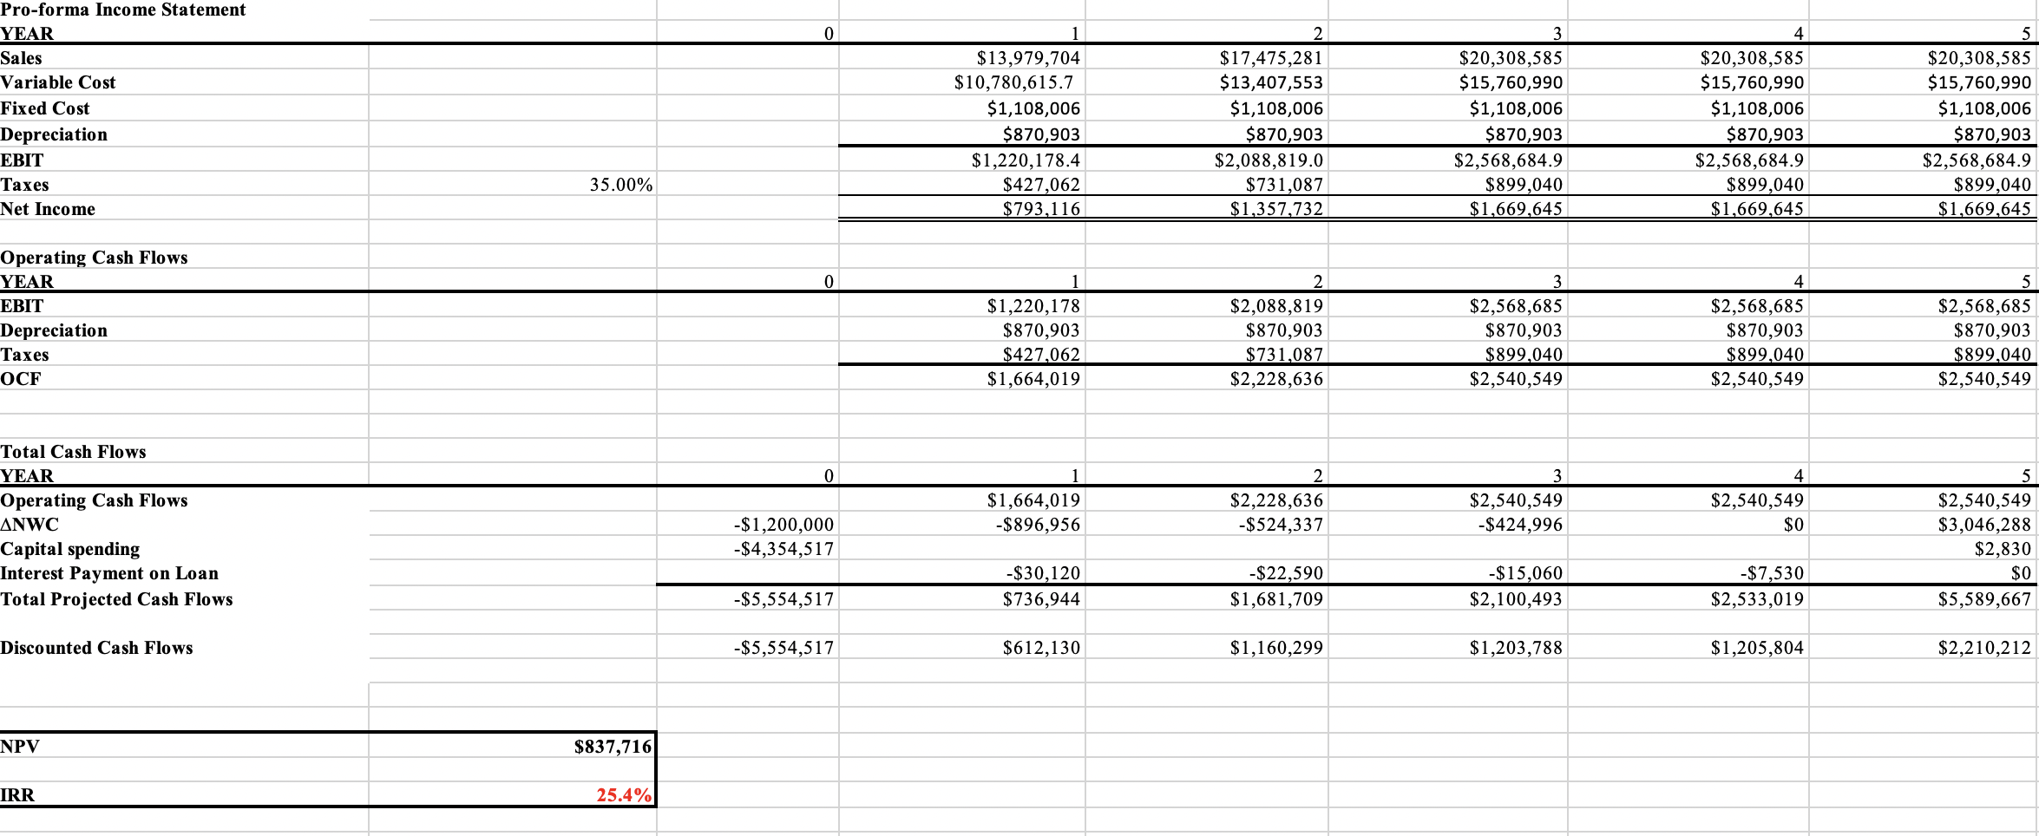
Capital Budgeting
14

Slide 15
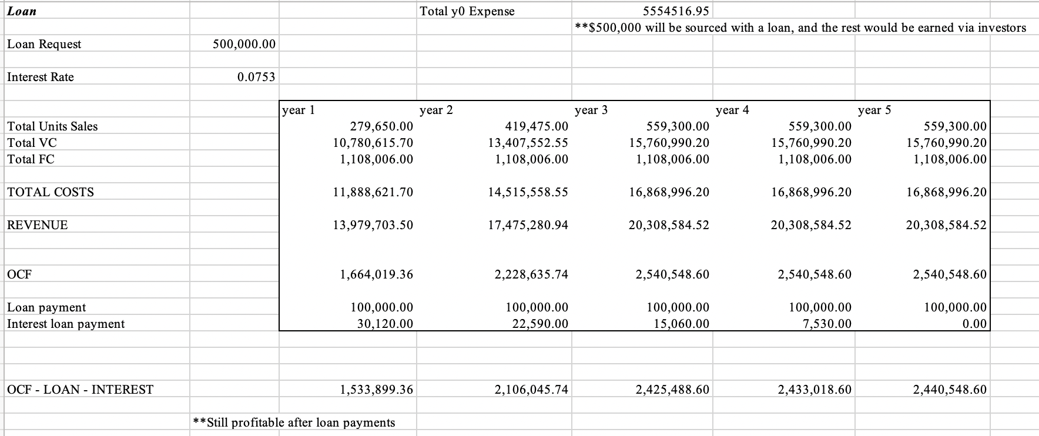
Financial Considerations
15

Slide 16
Sensitivity Analysis #1
Project is sensitive to a 10% decrease in sales
16

Slide 17
Sensitivity Analysis #2
Project is sensitive to a 5% increase in variable costs
17

Slide 18
Project Decision
Viable Target Market and Product Technology, Proceed to Further Develop an Investment Proposal
18

Slide 19
VolunteerUnited
Empowering volunteers. Enhancing impact.
Thank you
19

Slide 20
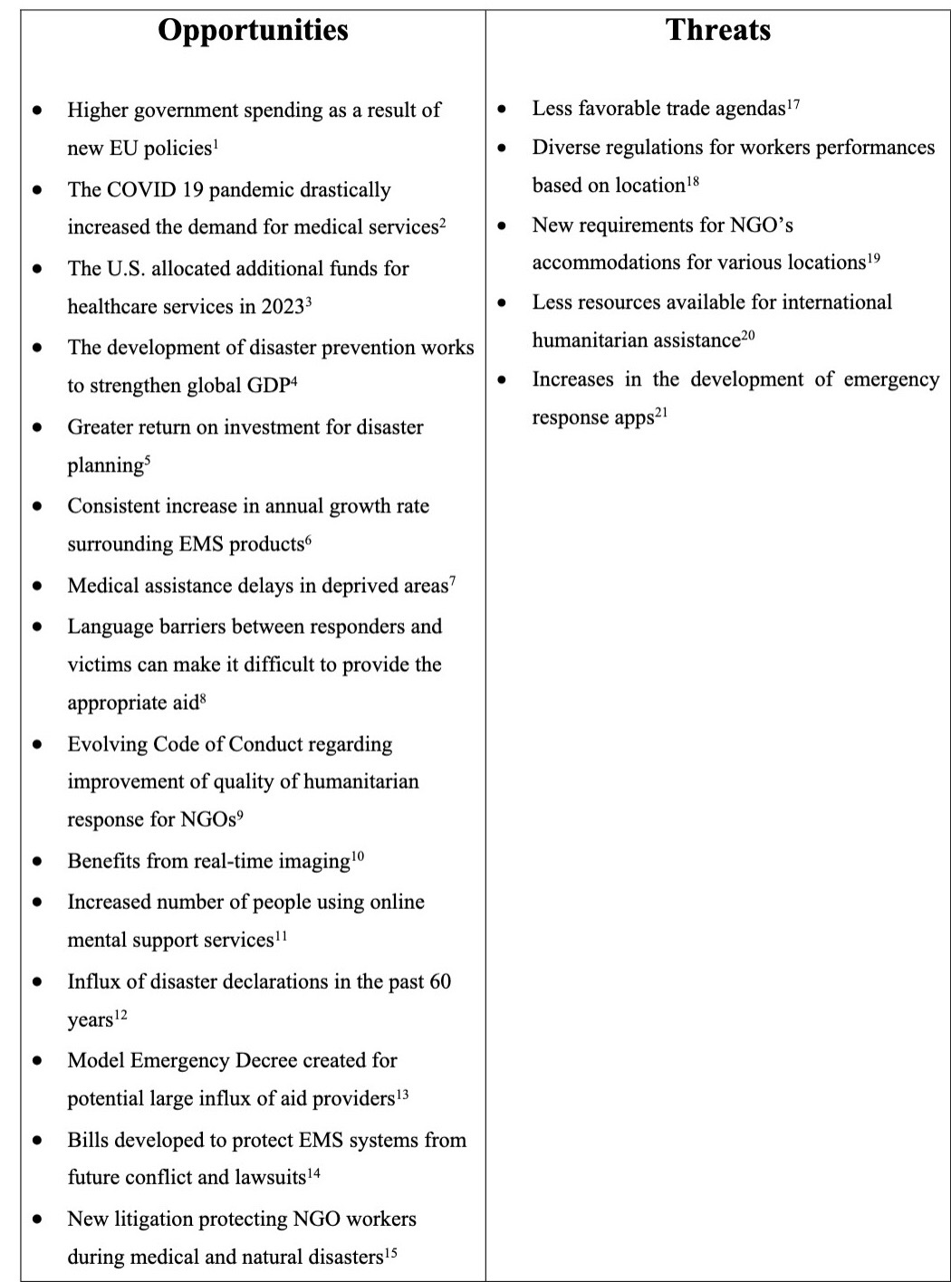
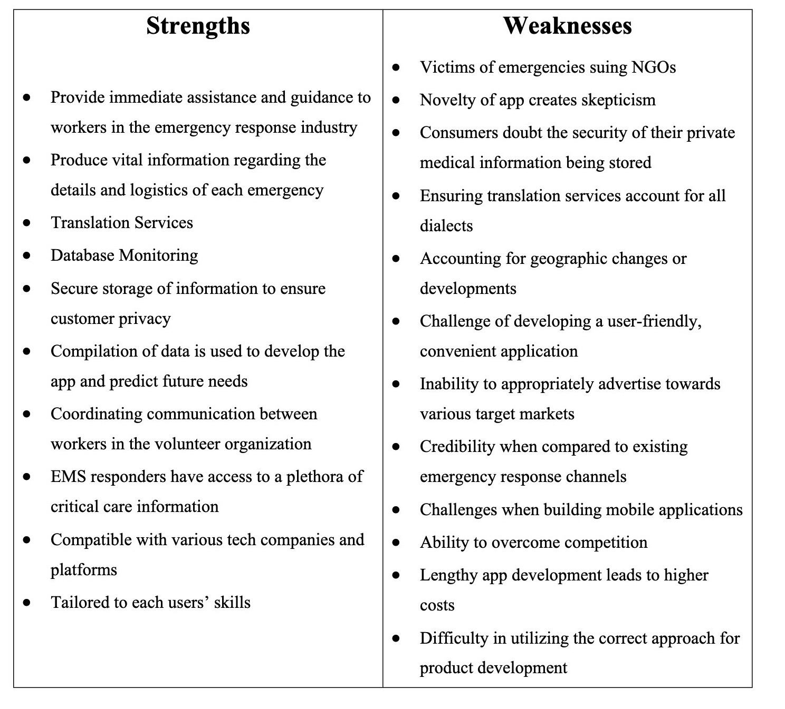
Appendix A: SWOT

Slide 21
Appendix B: Persona
Nicki is a 40-year-old woman who was raised in Springfield, Illinois. Nicki has two siblings, one brother and one sister. Most of Nicki’s family resides in the Midwest, while some of her family live on the East Coast. Nicki received her undergraduate degree in marketing from Miami University in Oxford, Ohio. She went on to pursue her MBA in Business Management from the Tuck School of Business at Dartmouth University. Nicki works as the CEO for the American Red Cross where she makes around $190,000 a year. Nicki’s knowledge of business management and desire to aid others during emergencies has shaped her desire to work as a CEO in the emergency response, NGO sector.
Nicki has always emphasized dispersing volunteer support over a wide variety of areas. This correlates to Nicki’s priorities of developing and maintaining a strong network of volunteers and donors. With proper funding and volunteer support, the American Red Cross can provide aid that aligns with the mission and values of the board and employees. Nicki believes that to implement aid across countries it is critical to ensure that employees lack bias, avoid political, racial, or religious agendas, and understand the importance of unity. Diversity must be respected by all members of the company, regardless of socioeconomic status, religious and political beliefs, or orientation. Nicki plans to instill new fundraising programs, expand the outreach of volunteers, and implement specialized IT systems to monitor the progress of the American Red Cross.
As a CEO, Nicki is responsible for making decisions that align with the c-suite of the organization and mission statement. Nicki provides valuable guidance surrounding long-term goals and milestones when buyers are directing purchasing decisions. Nicki positions the American Red Cross based on current events, market conditions, budget forecasting, and considerations of the c-suite. Nicki implements geographic and demographic segmentation to better understand the locational details, predict the type of aid required, and determine what volunteers would be best suited for a specific region.
Nicki will be required to crosscheck that her company is meeting all its goals in correlation to outreach, funding, and program development. Nick plans deadlines for various departments and determines what employees are reliable to achieve the company’s mission. Nicki ensures that purchase decisions align with the company’s values before confirming with the buying center. Nicki prioritizes efficient software and IT systems so there are no major technical issues. Nicki will need to ensure that new applications are financially feasible for the American Red Cross. Nicki and the American Red Cross will decide what legal partnership is to be implemented for the legal business structure.

Slide 22
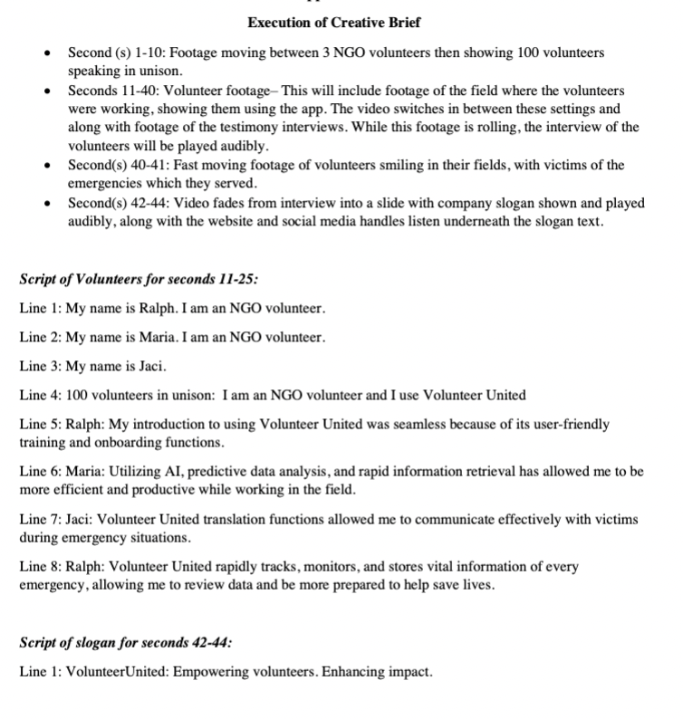
Appendix C: Promotional Plan

Slide 23
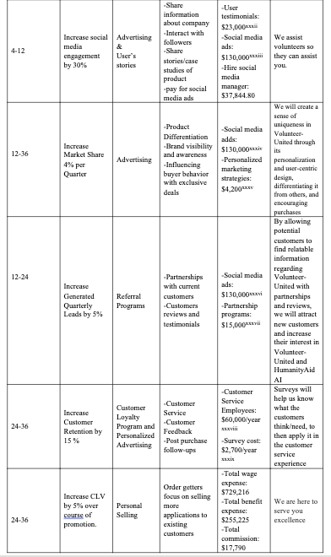
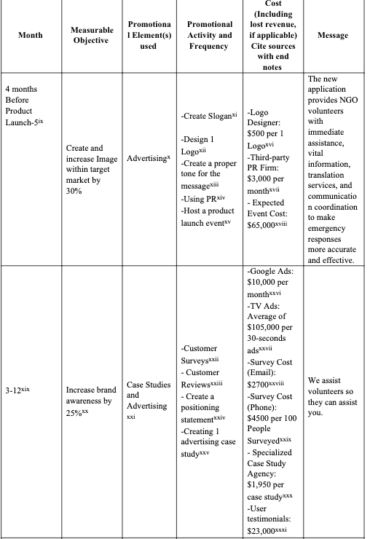
Appendix D: Promotional Plan

Slide 24
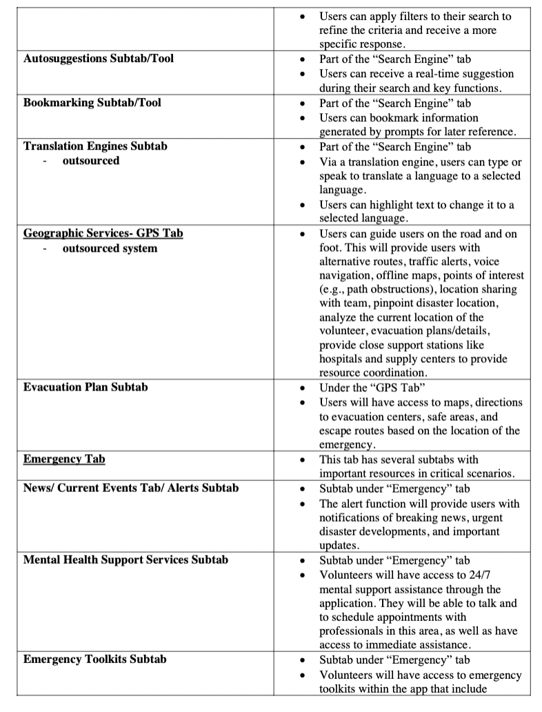
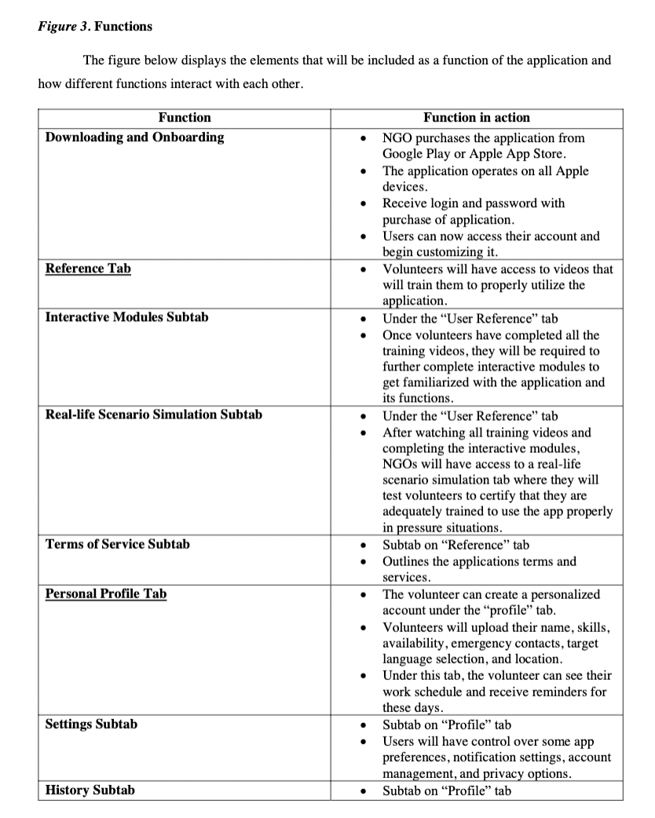
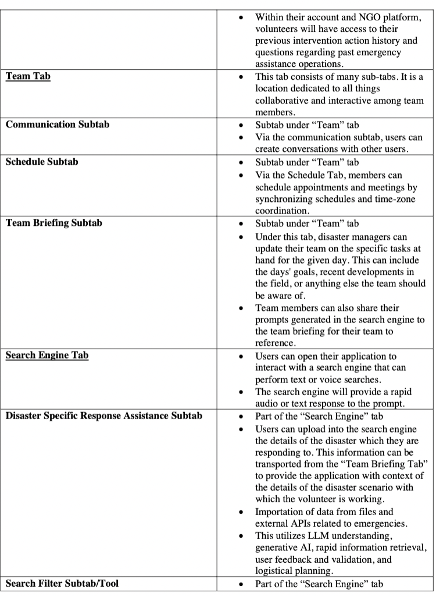
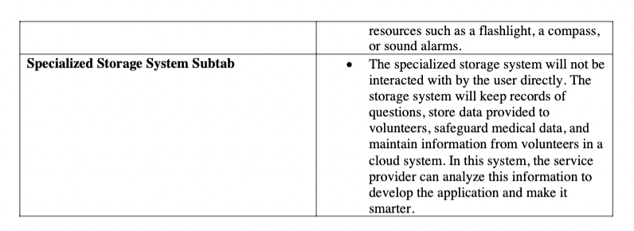
Appendix E: Functions

Slide 25
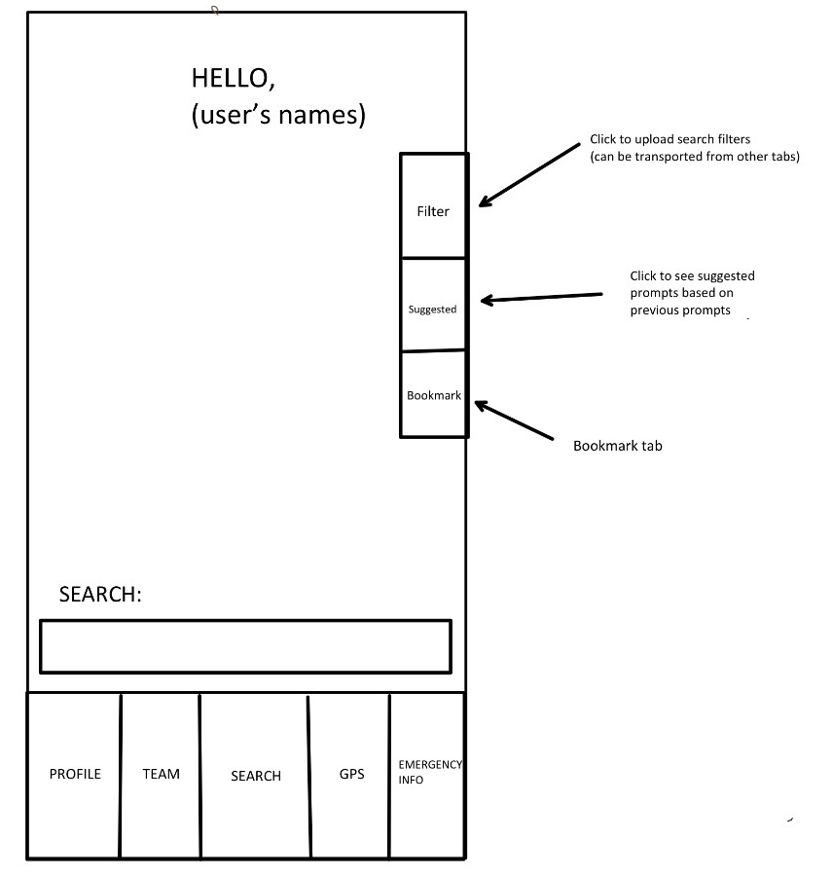
Appendix F: Wireframes

Slide 26
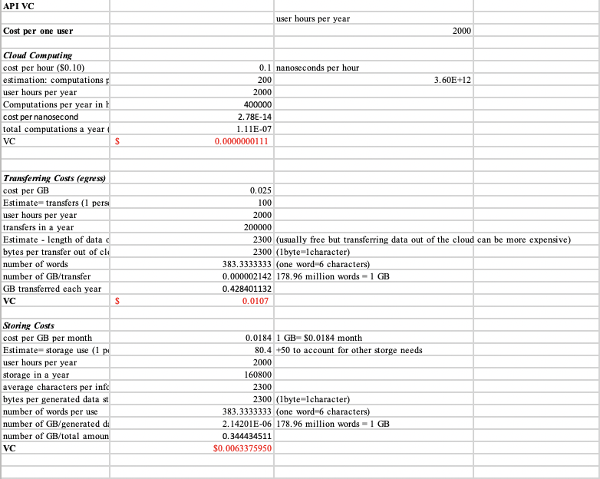
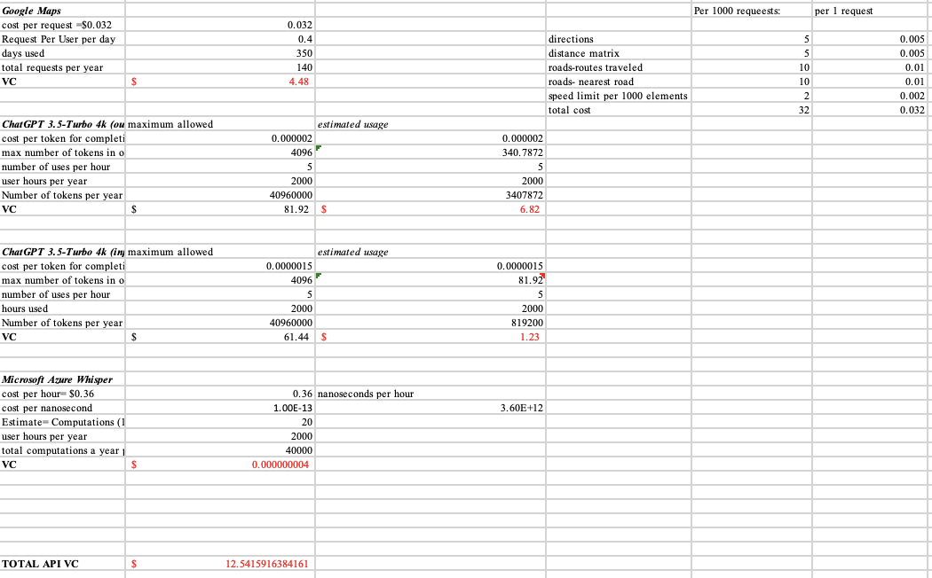
Appendix G: Cloud, Transferring, and Storing Costs & API Costs

Slide 27
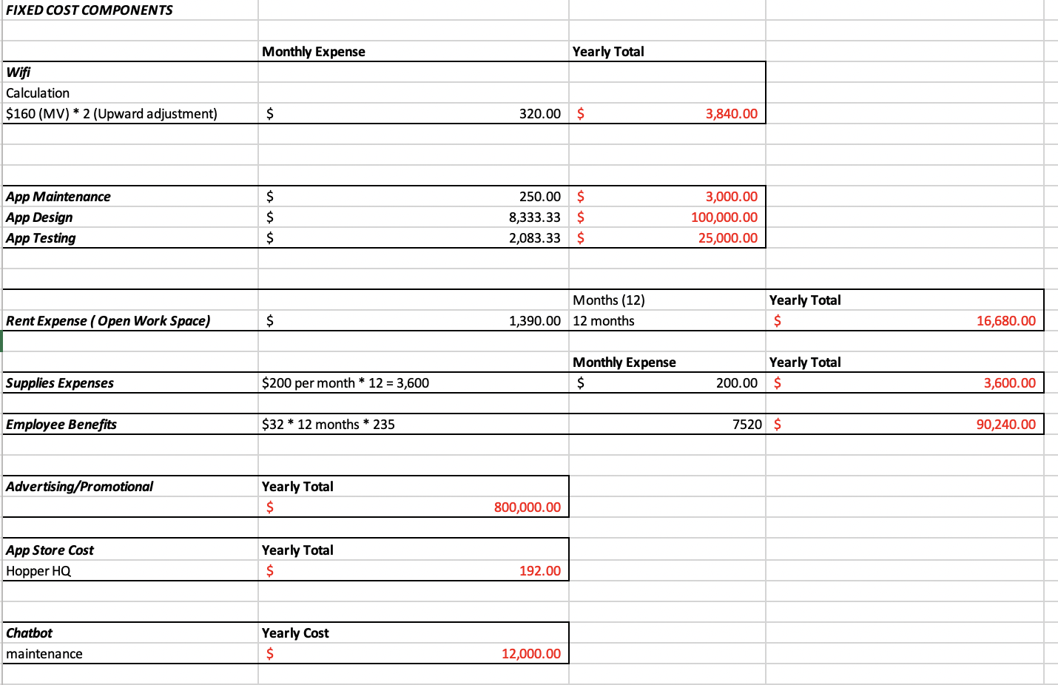
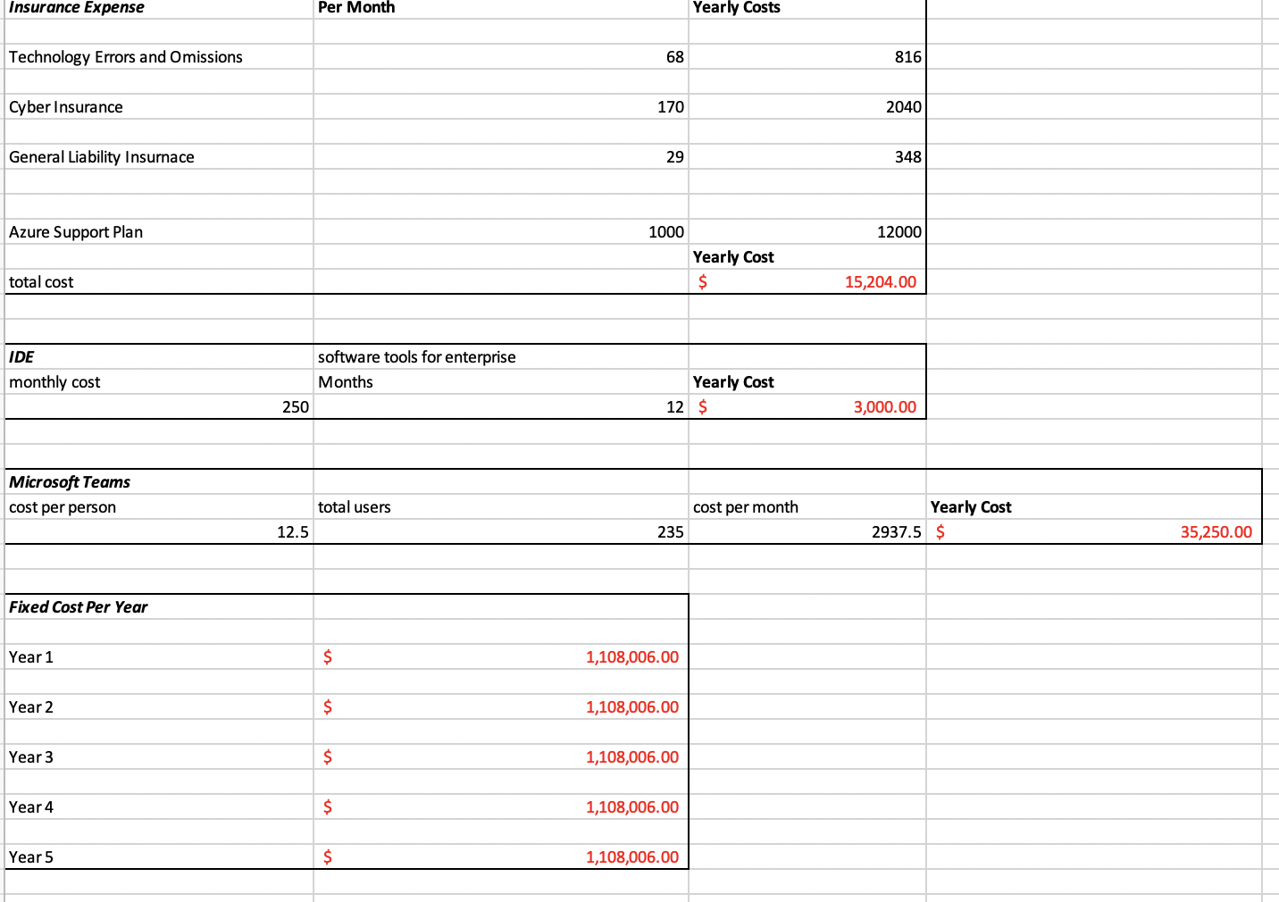
Appendix H: Fixed Costs

Slide 28
Appendix I: Labor Costs​

Slide 29
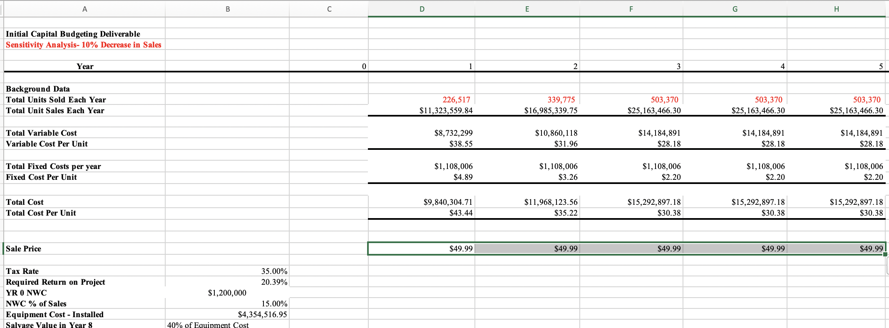
Appendix J: Sensitivity Analysis #1

Slide 30
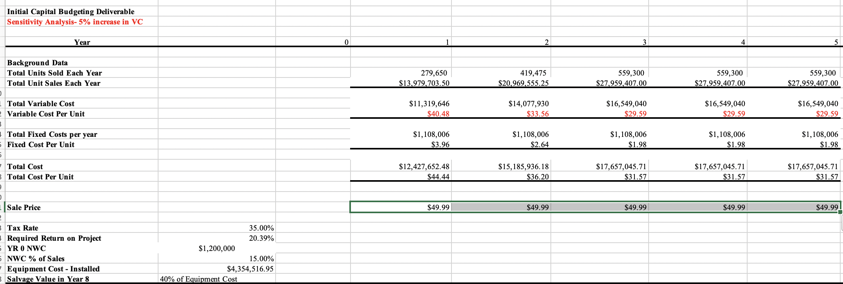
Appendix K: Sensitivity Analysis #2

